Slide 1
Logging made easy
May 31, 2019, Senet Eindhoven

Slide 2

Who is that weird guy talking to me?!
Pim Jansen
Software Architect Senet
Maintainer Faker
https://github.com/pimjansen
Notes:
Software development
voorheen DynaCommerce
Architecture
EventSourcing/CQRS/DDD

Slide 3
Before we start
Some basic knowledge of Elasticsearch
Comfortable with a linux terminal
Notes:
Who heard about ELK before?
Know something about logging in PHP / PSR-3

Slide 4
Here we go
Why and what do we log?
How do we log with PHP?
The Elastic Stack
Hosting
Basic installation
Usage

Slide 5


Slide 6
Why and what do we log?
What do you want to know of your system?
What are your users doing?
Tracking errors before end users complain
Notes:
Wie logt er?
Wie kijkt er nooit naar zn logs?
Wie logt er uberhaupt niet?

Slide 7
How do we log with PHP?
PSR-3 LoggerInterface
Monolog / Analog / Log4PHP
Log levels
Notes:
Other language frameworks: NLog Log4J

Slide 8
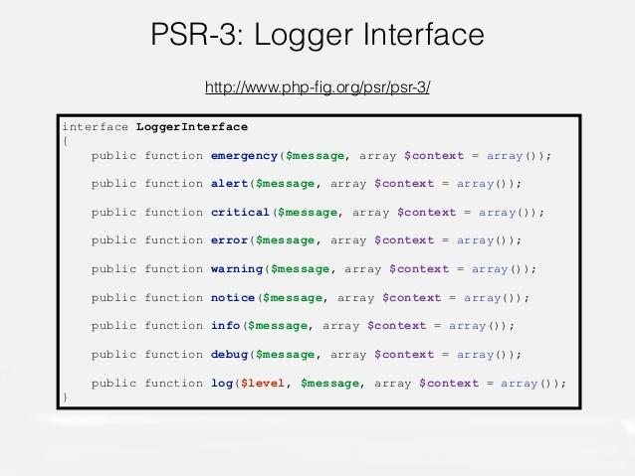

Slide 9
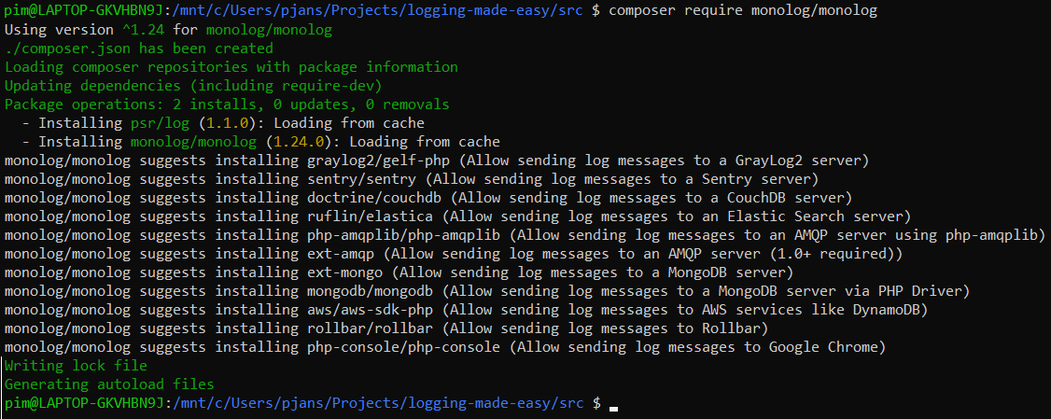
Implementing a basic logger
Notes:
Framework specific implementations

Slide 10
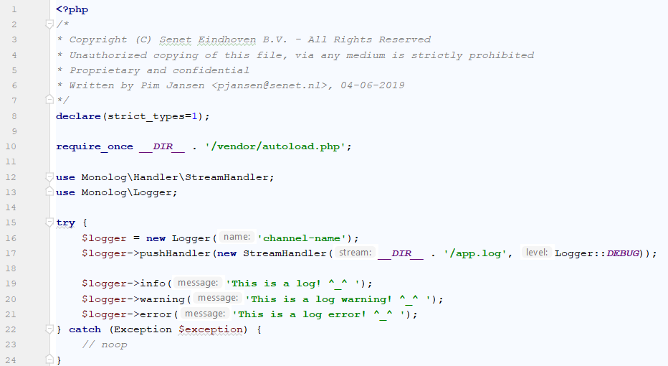
Notes:
Framework specific implementations
Specific handlers for other levels
NullLogger

Slide 11

How did it start?
Notes:
It started with an idea to add a simplified layer on top of Lucene

Slide 12

Evolving into Elasticsearch…
Notes:
Lucene is the source engine of ES

Slide 13
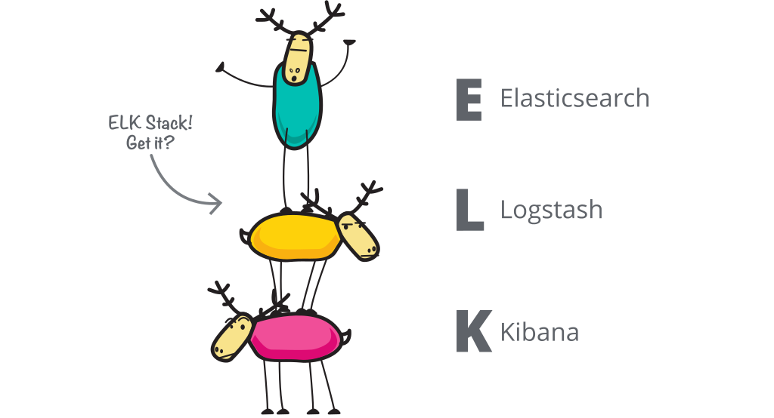
It grew with Logstash and Kibana
Notes:
ES - Elasticsearch is a distributed, JSON-based search and analytics engine.
Logstash - Logstash is a dynamic data collection pipeline with an extensible plugin ecosystem.
Kibana - Kibana is the window into the Elastic Stack. Explore your data and manage the stack.

Slide 14

Then we dropped a Beat on ELK
Notes:
Logstash is fairly heavy / java based system
You need to run that on each node to ship logs
Beats is a platform for lightweight shippers that send data from edge machines.

Slide 15

So, where did that leave ELK?
Notes:
Do we call it BELK? BLEK? ELKB?

Slide 16
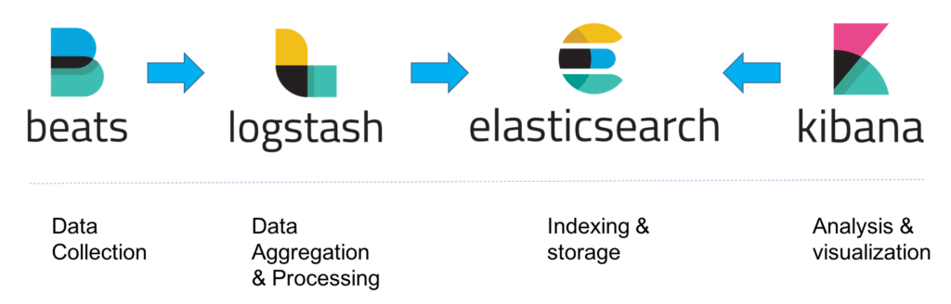
The Elastic Stack
Notes:
Beats:
Data collectie en logshipping
Logstash:
Data processing
Elasticsearch:
Data storage index
Kibana:
UI only visualization

Slide 17

Notes:
Trololol Yolo

Slide 18








Use cases
Logs
Infrastructure
APM
Uptime
Fast and scalable logging that won't quit
Monitor and visualize your system metrics.
Get insight into your application performance.
Monitor and react to availability issues across your apps and services.
Maps
SIEM
Site Search
App search
Explore location data in real time alongside your other Elasticsearch data.
Interactive investigation at speed and scale
Easily create a great search experience for your site.
Search across documents, geo data, and more.
Notes:
Missing Enterprise search

Slide 19

The Elastic Stack - Licensing
Notes:
Paid services like SIEM

Slide 20
The Elastic Stack - Installation Elasticsearch
Download via www.elastic.co for DEB/RPM
Install via yum or apt sudo yum install ./my-elastic-package.rpm sudo apt install ./my-elastic-package.deb
Start service systemctl start elasticsearch
Verify curl http://localhost:9200
Notes:
Configuration settings
Heap-size / memory usage (2G)
vm.max_map_count

Slide 21
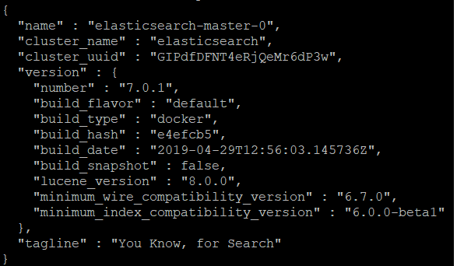
The Elastic Stack - Installation Elasticsearch
Notes:
Response Elasticsearch 7.0.1

Slide 22
The Elastic Stack - Installation Kibana
Download via www.elastic.co for DEB/RPM
Install via yum or apt sudo yum install ./my-elastic-package.rpm sudo apt install ./my-elastic-package.deb
Start service systemctl start kibana
Verify at http://<your-server-ip>:5601
Notes:
Configuration file for ES endpoint

Slide 23
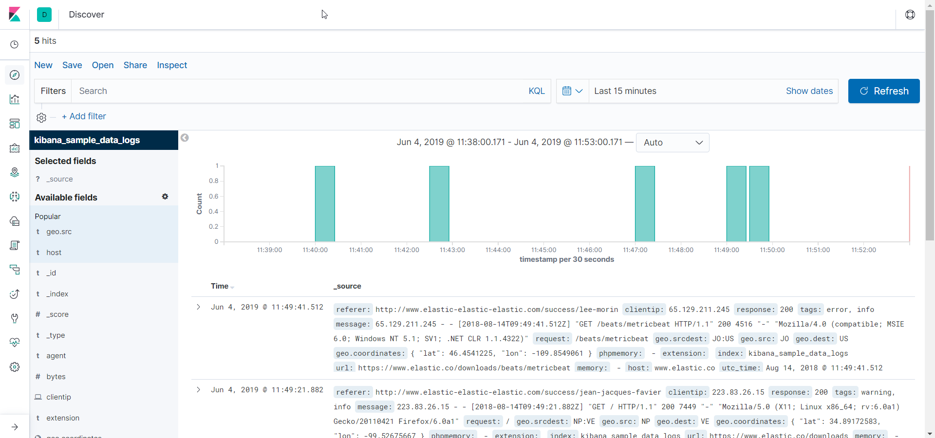
The Elastic Stack - Installation Kibana

Slide 24
The Elastic Stack - Installation Beats
Download via www.elastic.co for DEB/RPM
Install via yum or apt sudo yum install ./my-elastic-package.rpm sudo apt install ./my-elastic-package.deb
Start service systemctl start filebeat
Configure parsers + modules
Notes:
Filebeat modules
filebeat modules enable auditd
Apache module
Auditd module
Elasticsearch module
haproxy module
Iptables module
Kafka module
Kibana module
Logstash module
MongoDB module
MySQL module
Nginx module
PostgreSQL module
Redis module
System module
Traefik module

Slide 25

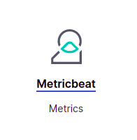
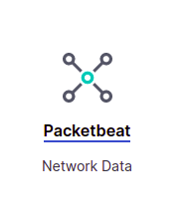
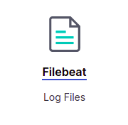

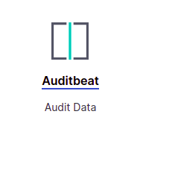
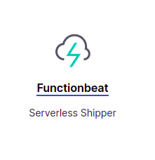
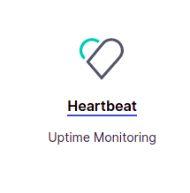
The Elastic Stack - Beats types
Notes:
Filebeat modules
filebeat modules enable auditd
Apache module
Auditd module
Elasticsearch module
haproxy module
Iptables module
Kafka module
Kibana module
Logstash module
MongoDB module
MySQL module
Nginx module
PostgreSQL module
Redis module
System module
Traefik module

Slide 26
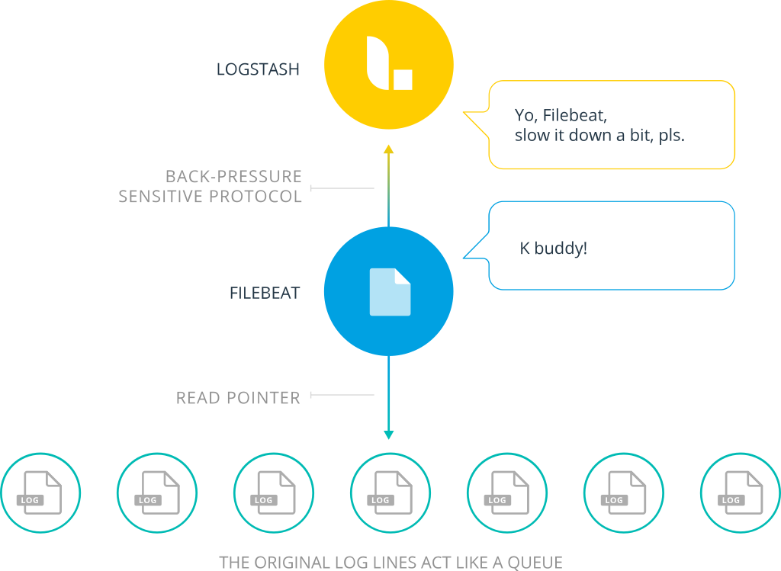
The Elastic Stack - High load

Slide 27
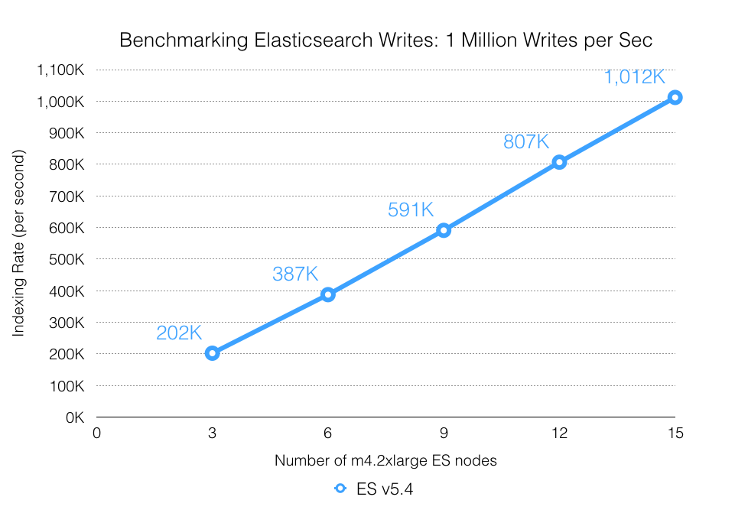
The Elastic Stack - Benchmark

Slide 28
Demo

Slide 29


Thank you!
https://github.com/pimjansen/talk-logging-made-easy
https://phpnl.slack.com

